Slide 1
Anne Riley
Author and Developer of
The
Ideasphere Theory
Media Kit
https://www.thehumanidea.com | anne.riley.pgw@gmail.com

Slide 2
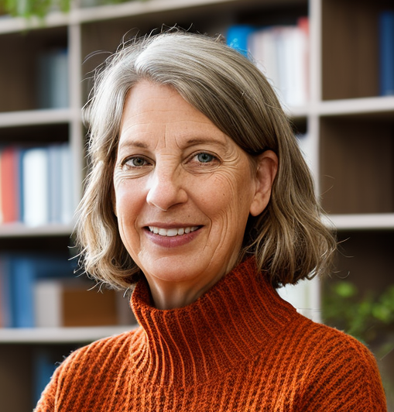
About Me
Anne Riley, born in Richland, Washington, is the eleventh of twelve children and grew up in Naperville, Illinois. She graduated from Illinois State University in 1981 with a degree in Accounting, earning the prestigious Bone Scholar award. She married her high school sweetheart , moved to the West Coast, and started a family. She earned an MBA from Portland State University. For many years, she balanced family life with a career in various industries, including technology, teaching, and finance, before retiring in 2011. Influenced by Michael Rothschild's Bionomics, Riley developed a theory known as the Ideasphere, exploring the parallels between human and ecological systems. Her theory is articulated in her novel DINA: Nature's Case for Democracy and a forthcoming non-fiction book The Human Idea, Nature's Newest Ecosystem. Riley's writing, characterized by humor and depth, aims to engage and improve the lives of her readers.
Contact
https://www.thehumanidea.com/| anne.riley.pgw@gmail.com 1.503.313.9047
ANNE RILEY AUTHOR

Slide 3
Speech Topics
The Ideasphere as a New Ecosystem
The Human Superpower: Choice
Information, DNA and the Nature of Ideas
Survival Mechanisms
The Importance of Education
https://www.thehumanidea.com/| anne.riley.pgw@gmail.com 1.503.313.9047
ANNE RILEY AUTHOR

Slide 4
Speeches/Podcasts/Conversations
COMING SOON
PODCASTS:
Raising Wild Hearts
With Ryann Watkins
Love Cast with Jamal
With Jamal Jivangee
Politically High Tech
With Elias Marty
Journey of My Mother’s Son
With Dan Clouser
Coup Save America
With Sean St. Heart
Radio Show
The Ideasphere
on The Ideasphere: A Platform for Today’s Voices
March 23, 2023
https://beta.prx.org/stories/467353
Coffee-Time-Again
With Dale Hutchinson
Do what you Want: Don’t harm Others
September 8, 2024
https://bit.ly/3ZKvLmr
https://www.thehumanidea.com/| anne.riley.pgw@gmail.com 1.503.313.9047
ANNE RILEY AUTHOR

Slide 5
Social Statistics
463
374
LinkedIn Connections
@Anne Riley
Twitter Followers
@Anne_Ideasphere
507
3
Facebook Friends
@Anne Riley
Youtube Subscribers
@thehumanideasphere
45
12
@anne_riley_ideasphere
anne_riley_ideasphere
https:/www.thehumanidea.com/| anne.riley.pgw@gmail.com 1.503.313.9047
ANNE RILEY AUTHOR

Slide 6
Let’s Discover Together
https://www.thehumanidea.com
https:/www.thehumanidea.com/| anne.riley.pgw@gmail.com 1.503.313.9047
THANK YOU

